Slide 1
W266 Natural Language Processing
Week 7: Language Modeling II

Slide 2
Peeking ahead...
Week 1- 2: NN Basics & Training
Week 3: Classification & Sentiment
Week 4: Part of Speech + Parsing
Week 5: Convolutional Neural Networks (CNNs)
Week 6 - 7: Language Models
Project Proposal Past Due
Week 8: Machine Translation
Week 9: Advanced MT: Transformers & Transfer Learning
Week 10: Entities/Information Extraction
Week 11: Summarization and a touch of question answering
Week 12: Document Classification
Week 13: Information Retrieval

Slide 3
Announcements
Assignment 5 (Language Models) - released this past Saturday 02/13
Due Sunday, Feb 21 (Tuesday 02/23 if you use late days)
Assignment 6 to be released Saturday 02/27.
Paper reading sessions:
How much knowledge can you pack into the parameters of a language model?
Mark: This Thursday 2/18 5:40 pm PST
Grammar as a Foreign Language
Mark: Next Thursday 2/25 5:40 pm PST
Project Proposals - Past Due (02/06)!
Feedback nearly complete.
Questions?
Concerns?

Slide 4
Language Models (2 Weeks): Agenda
Key Learnings Review & Beyond
Language Models: Motivation & Intuition
Neural Language Models 1: Simple Neural LM & Optimizations
Neural Language Models 2: Recurrent Neural Nets
Application of LMs: Context-aware embeddings with ELMO
Outlook: Transfer Learning with BERT, OpenAI GPT & Sentence Embeddings with USE
~ Week 6
~ Week 7

Slide 5
Key Learnings Review

Slide 6
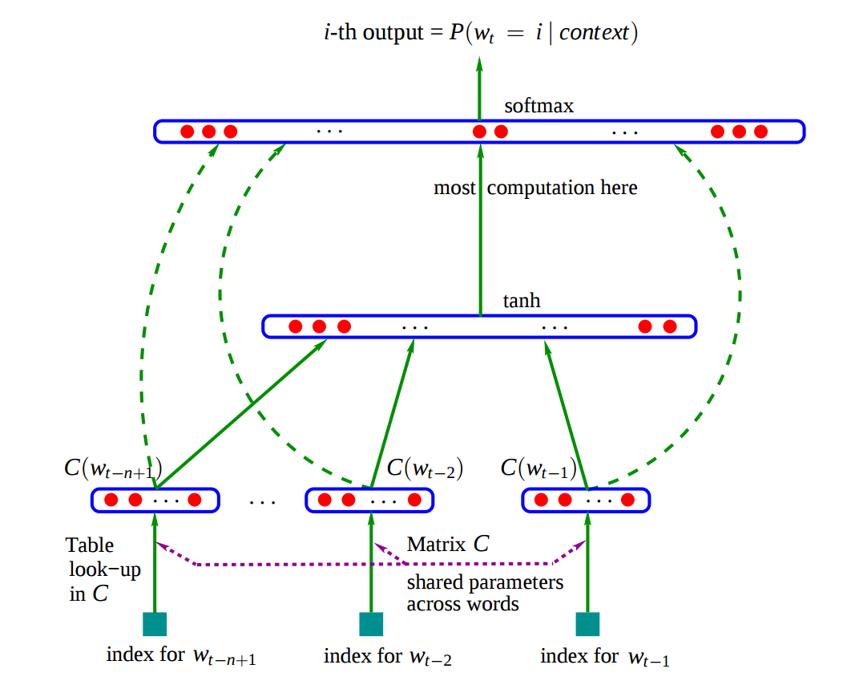
Language Model: Approaches Discussed
Build LM successively from prior sequences: Two approaches with limitations:
N-grams/Counting: window size, sparsity, ...
Simple Neural Language Model:
window size still an issue
What are the limitations? Can we do better?
Notes:
Limitations: blind to everything outside of the window
How to do better: RNNs & Attention based models

Slide 7
Language Models: Recurrent Neural Net Approach

Slide 8
Processing Sequences
VBN - Verb, past participle
VBD - Verb, past tense
Y₀ Y₁ Y₂ Y₃ Y₄ Y_{5 ...} Y_{n}
Output
Time
X₀ X₁ X₂ X₃ X₄ X_{5 ...} X_{n}
Input
Example: Part of Speech Tagging (i.e., identify nouns, verbs, etc...) Input: The beautiful horse raced past the barn..
Question: What is the tag for ‘raced’?

Slide 9
Processing Sequences
VBN - Verb, past participle
VBD - Verb, past tense
Y₀ Y₁ Y₂ Y₃ Y₄ Y_{5 ...} Y_{n}
Output
Time
X₀ X₁ X₂ X₃ X₄ X_{5 ...} X_{n}
Input
Example: Part of Speech Tagging (i.e., identify nouns, verbs, etc...) Input: The beautiful horse raced past the barn fell.
Question: What is the tag for ‘raced’?

Slide 10
Processing Sequences
VBN - Verb, past participle
VBD - Verb, past tense
How should we handle sequence data?
Y₀ Y₁ Y₂ Y₃ Y₄ Y_{5 ...} Y_{n}
Output
Time
X₀ X₁ X₂ X₃ X₄ X_{5 ...} X_{n}
Input
Example: Part of Speech Tagging (i.e., identify nouns, verbs, etc...) Input: The beautiful horse raced past the barn fell.
Question: What is the tag for ‘raced’? Answer: The/DT beautiful/ADJ horse/NN raced/VBN past/JJ the/DT barn/NN fell/VBD ./.
Clearly the answer requires the sequence!
Notes:
Sid: I don’t think this is a good example

Slide 11
Processing Sequences
VBN - Verb, past participle
VBD - Verb, past tense
How should we handle sequence data?
Problem (1) Basic neural networks assume fixed dimensional inputs and outputs.
Y₀ Y₁ Y₂ Y₃ Y₄ Y_{5 ...} Y_{n}
Output
Time
X₀ X₁ X₂ X₃ X₄ X_{5 ...} X_{n}
Input
Example: Part of Speech Tagging (i.e., identify nouns, verbs, etc...) Input: The beautiful horse raced past the barn fell.
Question: What is the tag for ‘raced’? Answer: The/DT beautiful/ADJ horse/NN raced/VBN past/JJ the/DT barn/NN fell/VBD ./.
Clearly the answer requires the sequence!

Slide 12
Processing Sequences
VBN - Verb, past participle
VBD - Verb, past tense
How should we handle sequence data?
Problem (1) Basic neural networks assume fixed dimensional inputs and outputs.
Solution Construct a network along the sequence
Y₀ Y₁ Y₂ Y₃ Y₄ Y_{5 ...} Y_{n}
Output
Time
X₀ X₁ X₂ X₃ X₄ X_{5 ...} X_{n}
Input
Example: Part of Speech Tagging (i.e., identify nouns, verbs, etc...) Input: The beautiful horse raced past the barn fell.
Question: What is the tag for ‘raced’? Answer: The/DT beautiful/ADJ horse/NN raced/VBN past/JJ the/DT barn/NN fell/VBD ./.
Clearly the answer requires the sequence!

Slide 13
Processing Sequences
VBN - Verb, past participle
VBD - Verb, past tense
How should we handle sequence data?
Problem (1) Basic neural networks assume fixed dimensional inputs and outputs.
Solution Construct a network along the sequence
Problem (2) Sentences vary in length, weights for longer sequence positions would rarely be trained.
Y₀ Y₁ Y₂ Y₃ Y₄ Y_{5 ...} Y_{n}
Output
Time
X₀ X₁ X₂ X₃ X₄ X_{5 ...} X_{n}
Input
Example: Part of Speech Tagging (i.e., identify nouns, verbs, etc...) Input: The beautiful horse raced past the barn fell.
Question: What is the tag for ‘raced’? Answer: The/DT beautiful/ADJ horse/NN raced/VBN past/JJ the/DT barn/NN fell/VBD ./.
Clearly the answer requires the sequence!

Slide 14
Processing Sequences
VBN - Verb, past participle
VBD - Verb, past tense
How should we handle sequence data?
Problem (1) Basic neural networks assume fixed dimensional inputs and outputs.
Solution Construct a network along the sequence
Problem (2) Sentences vary in length, weights for longer sequence positions would rarely be trained.
Solution Reuse the same weights at different positions. (stopping here could give us basic Kim style CNNs)
Y₀ Y₁ Y₂ Y₃ Y₄ Y_{5 ...} Y_{n}
Output
Time
X₀ X₁ X₂ X₃ X₄ X_{5 ...} X_{n}
Input
Example: Part of Speech Tagging (i.e., identify nouns, verbs, etc...) Input: The beautiful horse raced past the barn fell.
Question: What is the tag for ‘raced’? Answer: The/DT beautiful/ADJ horse/NN raced/VBN past/JJ the/DT barn/NN fell/VBD ./.
Clearly the answer requires the sequence!
Notes:
Ask students if RNNs discussed on the next slides could handle example. Answer: They can’t without being bidirectional.
Basic NN
beautiful/ADJ horse/NN raced -> VBN
the/DT barn/NN fell -> VBD

Slide 15
Processing Sequences
VBN - Verb, past participle
VBD - Verb, past tense
How should we handle sequence data?
Problem (1) Basic neural networks assume fixed dimensional inputs and outputs.
Solution Construct a network along the sequence
Problem (2) Sentences vary in length, weights for longer sequence positions would rarely be trained.
Solution Reuse the same weights at different positions. (stopping here could give us basic Kim style CNNs)
Problem (3) Network should still strive to understand sentence as whole.
Y₀ Y₁ Y₂ Y₃ Y₄ Y_{5 ...} Y_{n}
Output
Time
X₀ X₁ X₂ X₃ X₄ X_{5 ...} X_{n}
Input
Example: Part of Speech Tagging (i.e., identify nouns, verbs, etc...) Input: The beautiful horse raced past the barn fell.
Question: What is the tag for ‘raced’? Answer: The/DT beautiful/ADJ horse/NN raced/VBN past/JJ the/DT barn/NN fell/VBD ./.
Clearly the answer requires the sequence!
Notes:
Ask students if RNNs discussed on the next slides could handle example. Answer: They can’t without being bidirectional.
Basic NN
beautiful/ADJ horse/NN raced -> VBN
the/DT barn/NN fell -> VBD

Slide 16
Processing Sequences
VBN - Verb, past participle
VBD - Verb, past tense
How should we handle sequence data?
Problem (1) Basic neural networks assume fixed dimensional inputs and outputs.
Solution Construct a network along the sequence
Problem (2) Sentences vary in length, weights for longer sequence positions would rarely be trained.
Solution Reuse the same weights at different positions. (stopping here could give us basic Kim style CNNs)
Problem (3) Network should still strive to understand sentence as whole.
Solution a) Introduce memory cells (RNNs) this week! b) Sequence-wide attention (Transformers)
Y₀ Y₁ Y₂ Y₃ Y₄ Y_{5 ...} Y_{n}
Output
Time
X₀ X₁ X₂ X₃ X₄ X_{5 ...} X_{n}
Input
Example: Part of Speech Tagging (i.e., identify nouns, verbs, etc...) Input: The beautiful horse raced past the barn fell.
Question: What is the tag for ‘raced’? Answer: The/DT beautiful/ADJ horse/NN raced/VBN past/JJ the/DT barn/NN fell/VBD ./.
Clearly the answer requires the sequence!
Notes:
Ask students if RNNs discussed on the next slides could handle example. Answer: They can’t without being bidirectional.
Basic NN
beautiful/ADJ horse/NN raced -> VBN
the/DT barn/NN fell -> VBD

Slide 17
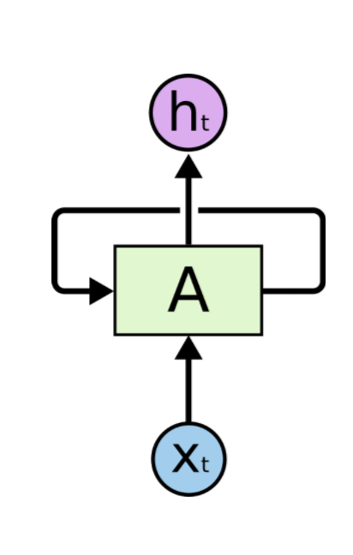
Intro: Recurrent Neural Networks (RNN)
Y₀ Y₁ Y₂ Y₃ Y₄ Y_{5 ...} Y_{n}
Output
How can we combine information across a sequence?
Idea Repeat the same sub-network at each position and combine information across the sequence by feeding output of pos_{n} as (another) input for pos_{n+1}
System has “memory”
Time
X₀ X₁ X₂ X₃ X₄ X_{5 ...} X_{n}
Input
h₄
RNN
RNN
SRN
h₃
h_{A}
h₂
h_{A}
h₁
h_{A}
h₀
h_{A}
h_{A}
Diagram from Colah's Understanding LSTM Networks http://colah.github.io/posts/2015-08-Understanding-LSTMs/
X₀ X₁ X₂ X₃ X_{4 ...}

Slide 18
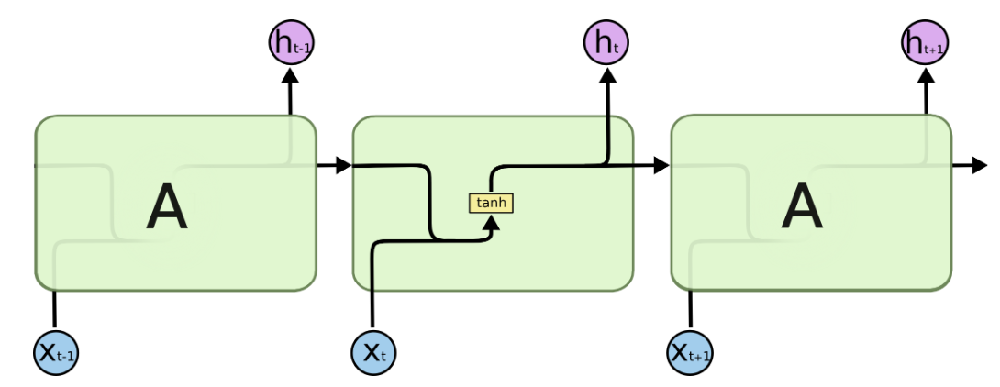

Simple Recurrent Neural Net
Question: “If dim(h_t) = dim(x_t) = 100.. What is the dimension of W?”
Diagram from Colah's Understanding LSTM Networks http://colah.github.io/posts/2015-08-Understanding-LSTMs/

Slide 19
Simple Recurrent Neural Net
2
2
2
Multi-Layer RNNs... Question: “If dim(h¹) = 100 and dim(h²) = 50 .. What is the dimension of W²?”
1
1
1

Slide 20
Simple Recurrent Neural Net
All Good? Not Quite!
Long sequences construct long networks
Ability to recall ‘old’ information is limited
Vanishing gradients
Slow - sequential execution required
Diagram from Colah's Understanding LSTM Networks http://colah.github.io/posts/2015-08-Understanding-LSTMs/

Slide 21
Backpropagation with RNNs
Important for really understanding RNNs

Slide 22

Backpropagation - Now with Time?
Needed for error backpropagation

Slide 23
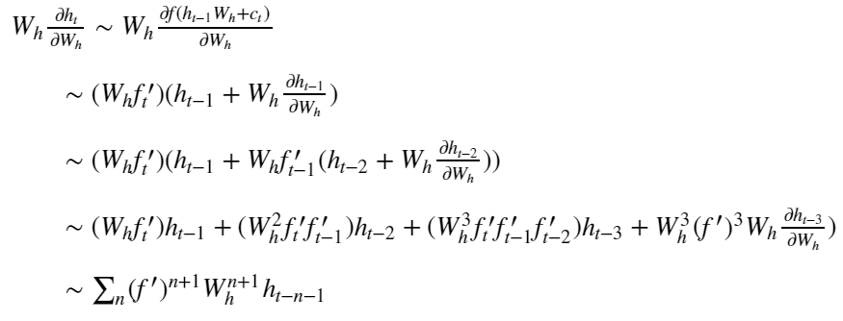
SRR: How Does W_{h} affect h_{t}?
Not actual ‘BPTT’.. just illustration of how change in W has effects across many time steps.
Some math, conceptually - ignoring indices...
f = tanh()
c_{t} = x_{t} W_{x} + b

Slide 24
SRR: How Does W_{h} affect h_{t}?
Not actual ‘BPTT’! Just illustration of how change in W has effects across many time steps.
Some math, conceptually - ignoring indices...
f_{t} = tanh(h_{t-1} W_{h} + c_{t})
f’(z) = ∂f/∂z

Slide 25
SRR: How Does W_{h} affect h_{t}?
Not actual ‘BPTT’! Just illustration of how change in W has effects across many time steps.
Some math, conceptually - ignoring indices...

Slide 26
SRR: How Does W_{h} affect h_{t}?
Not actual ‘BPTT’! Just illustration of how change in W has effects across many time steps.
Some math, conceptually - ignoring indices...
What is the problem for long-range learning?
‘Sloppy’ for f’(W_{h}h_{t-1} + ...) x f’(W_{h}h_{t-2} +.. ) x... f’()

Slide 27
SRR: How Does W_{h} affect h_{t}?
Not actual ‘BPTT’! Just illustration of how change in W has effects across many time steps.
Some math, conceptually - ignoring indices...
What if (f’ W) < 1? What if (f’ W) > 1?
Vanishing/exploding gradient problem!

Slide 28
Recurrent Neural Networks
Back to....

Slide 29
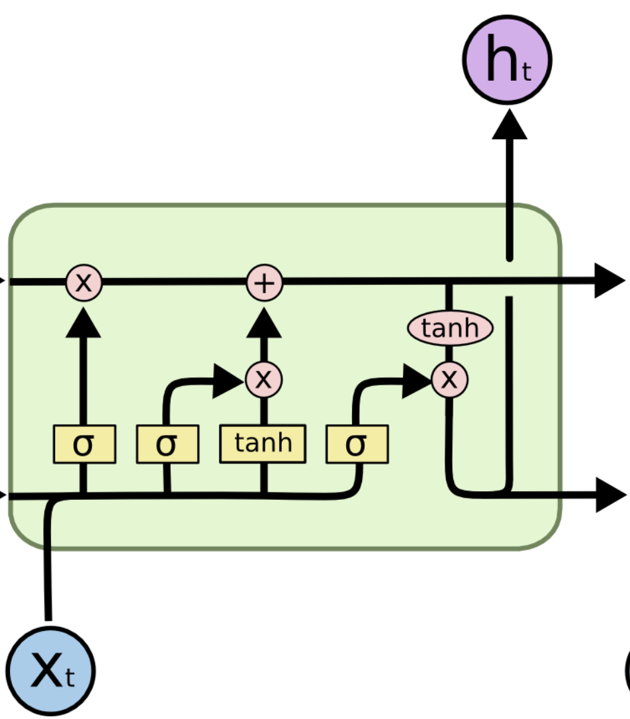

Better Gradients: Long Short-Term Memory (LSTM)
What if hidden units could hold onto their own activation memory until they are needed?
Idea replace hidden units with memory cells designed to remember information until its needed. Cell State holds information from one time step to the next. Forget gate selects when to forget info. that is no longer useful. Input gate selects what and how to update. Output gate selects when to expose contents.
Cell state c
Design Features
Forget G.
Input
Output G.
Diagram from Colah's Understanding LSTM Networks http://colah.github.io/posts/2015-08-Understanding-LSTMs/
Notes:
x_{\mathrm{gated}} = \sigma(x, h_{t-1})\, x

Slide 30
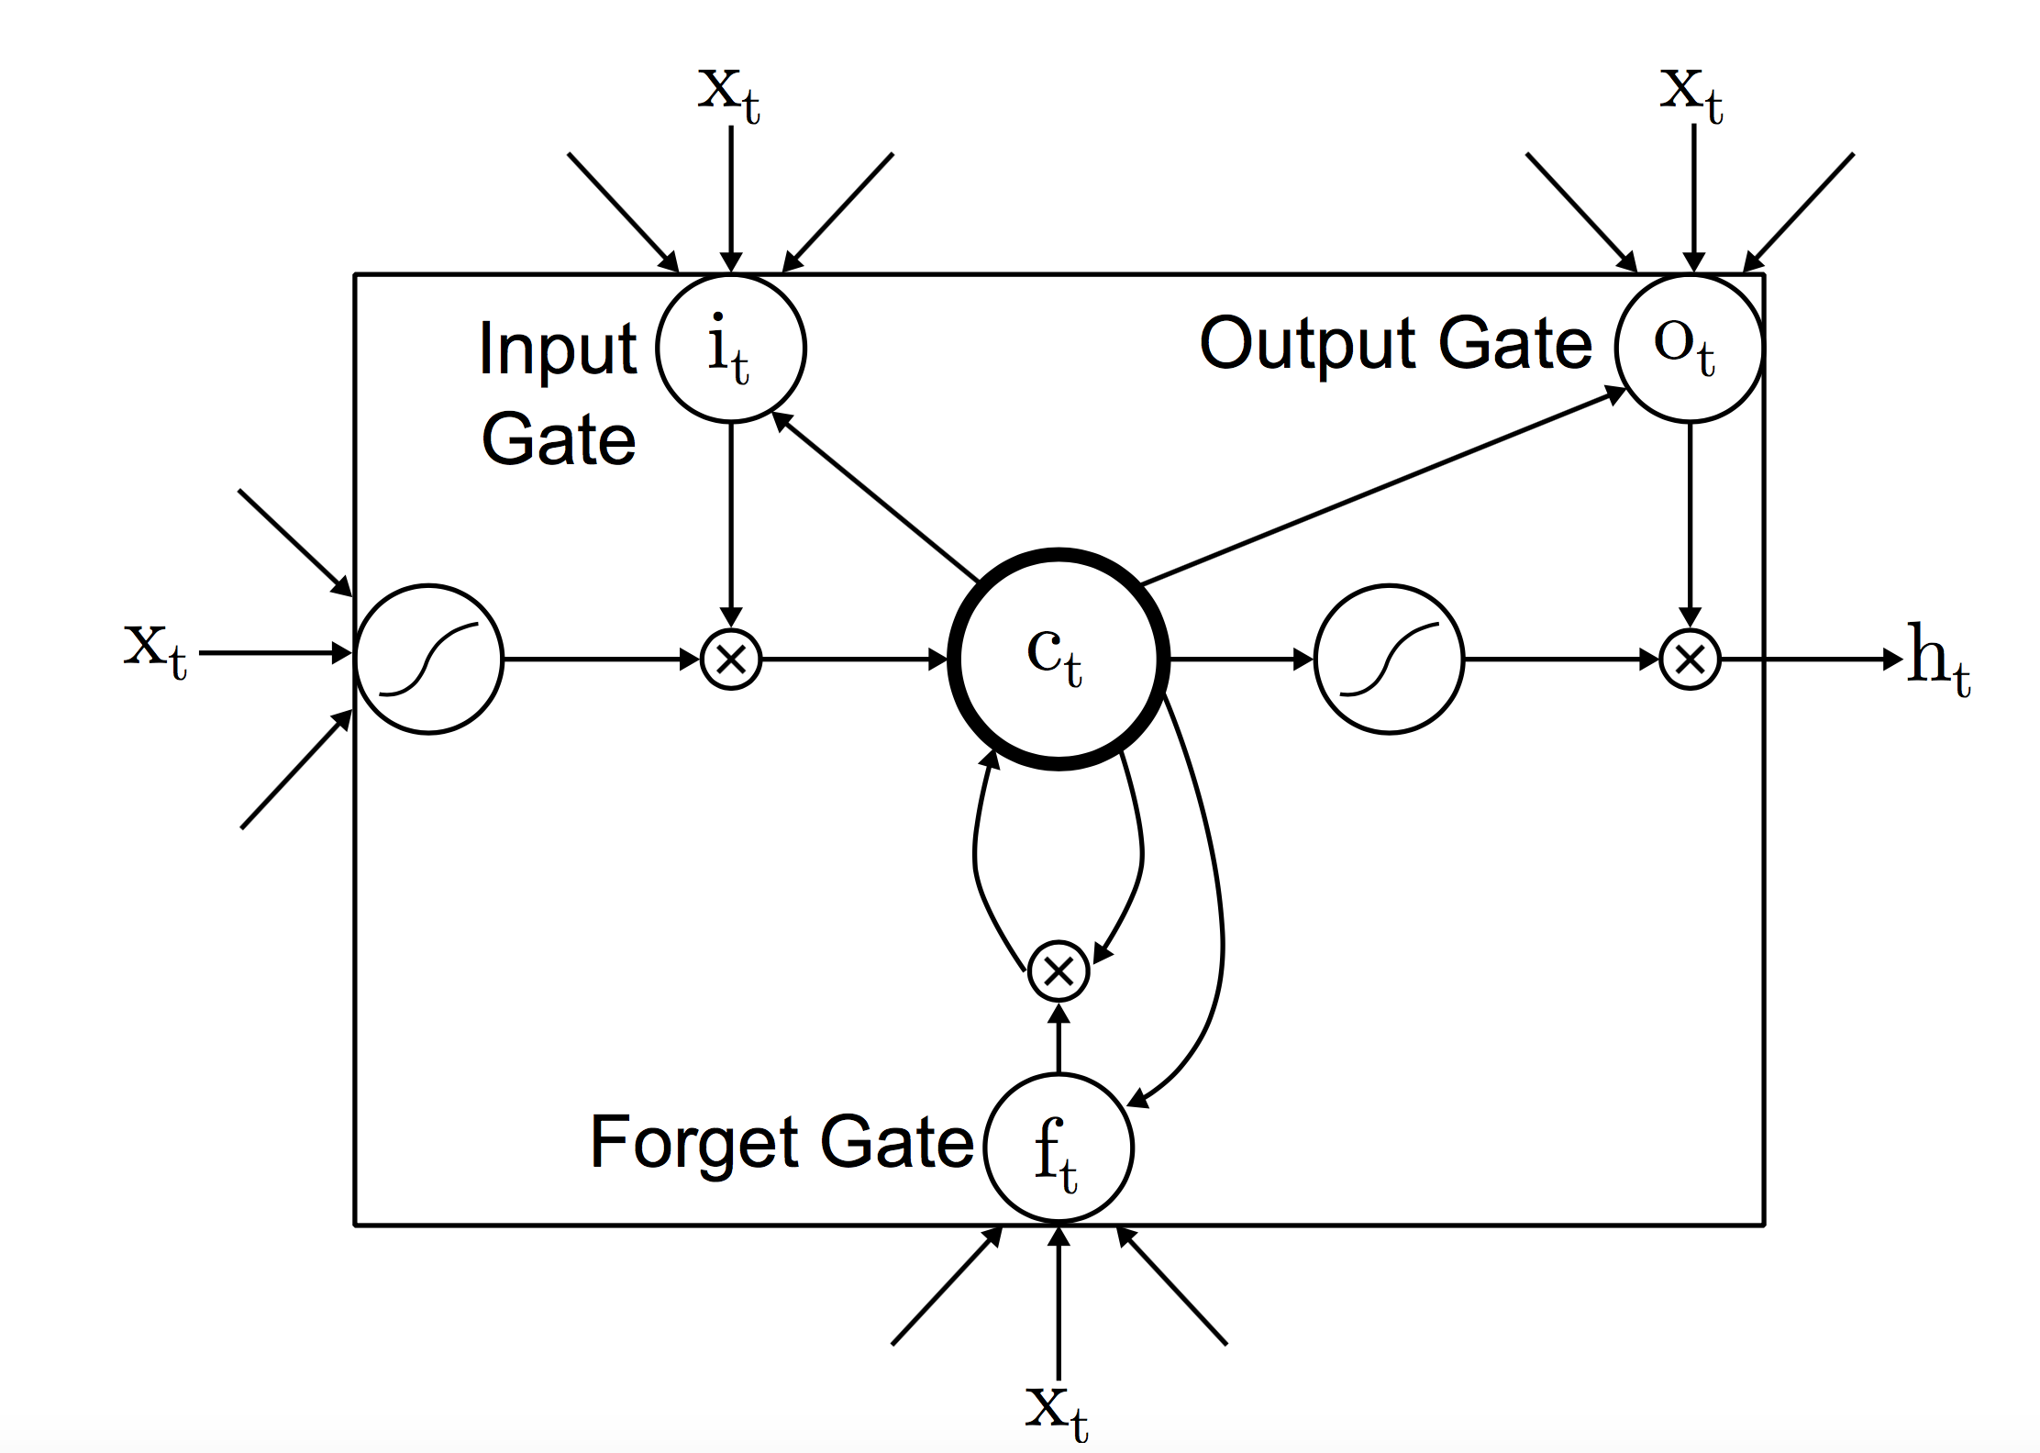
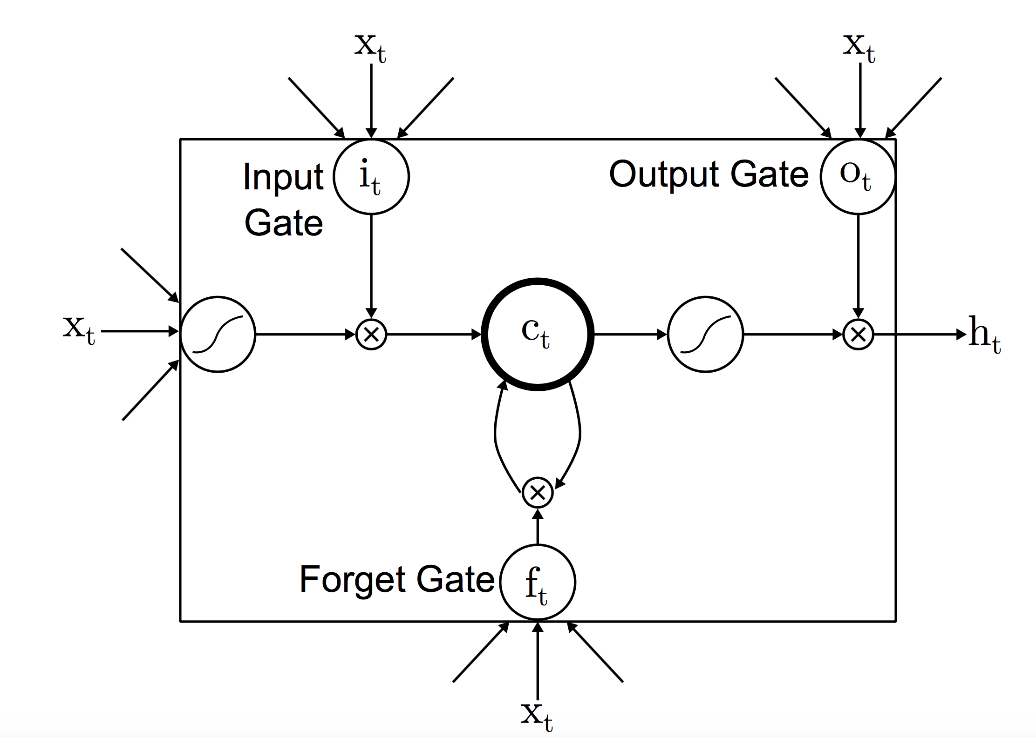
LSTM (another look)
i_{t} = σ (x_{t}W_{xi} + h_{t−1}W_{hi} + b_{i}) | (1)
f_{t} = σ (x_{t}W_{xf} + h_{t−1}W_{hf} + b_{f}) | (2)
o_{t} = σ (x_{t}W_{xo} + h_{t−1}W_{ho} + b_{o}) | (3)
c_{t} = f_{t}⋅ c_{t−1} + i_{t} σ (x_{t}W_{xc} + h_{t−1}W_{hc} + b_{c} ) | (4)
h_{t} = o_{t}⋅ tanh(c_{t}) | (5)
b_{c}
h_{t-1}
Notes:
h_{t} = tanh(x_{t}W_{x} + h_{t−1}W_{h} + b)

Slide 31
LSTM Tasks
What tasks are a good fit for LSTMs?
Sequence Labeling
Part-of-speech tagging (POS), word sense disambiguation (WSD), syntactic chunking, named entity recognition (NER), Information Extraction (IE), Event Detection. Sequence Transduction
Chatbots (Vinyals and Le 2015), Response Suggestion (Kannan et al., 2016) Machine Translation (Wu et al., 2016), Abstractive Summarization (Chopra et al., 2016), Text Simplification (Wang et al., 2016)
… + Language Modeling!
Cell state
Forget G.
Input
Output G.
Diagram from Colah's Understanding LSTM Networks http://colah.github.io/posts/2015-08-Understanding-LSTMs/
Notes:
x_{\mathrm{gated}} = \sigma(x, h_{t-1})\, x

Slide 32
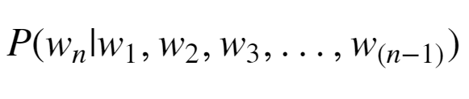

LSTMs in LM Architectures: Inference
(FCC +) Affine Layer + Softmax
The key quantity for language models!
w₁ …. w_{n-1}

Slide 33
LSTMs in LM Architectures: Training
Desired Output (Labels)
like this book
Softmax
Softmax
Softmax
FCC/Affine Layer + Softmax
(FCC +) Affine Layer
(FCC +) Affine Layer
(FCC +) Affine Layer
One or more LSTM layers
Input (w/ Embedding)
I like this book

Slide 34
Problems with LSTMs
Are LSTMs the solution to all language problems?
Vanishing gradients are still a problem as sources of gradient noise still present at each time step. Forgetful by the end of the sequence the LSTM may have forgotten the beginning. Emphasis on local context easier to learn and use information over short distances Design limits GPU acceleration due to sequential dependencies.
Partial solutions Skip connections, bi-LSTM, attention, use alternative network (CNNs, Transformer)
Forget G.
Input G.
Input
Output G.
Diagram from Colah's Understanding LSTM Networks http://colah.github.io/posts/2015-08-Understanding-LSTMs/
Notes:
x_{\mathrm{gated}} = \sigma(x, h_{t-1})\, x

Slide 35
LSTM References
ftp://ftp.idsia.ch/pub/juergen/lstm.pdf
http://colah.github.io/posts/2015-08-Understanding-LSTMs/

Slide 36
Wait….
For each word w there is an embedding vector x and an LSTM output vector h. Hmmmm….

Slide 37
Context-Aware Embeddings with ELMO

Slide 38
What Can We Do Now?
“Hmmm…
I am sending in a sequence of word embeddings…
from the LSTM I get a sequence of vectors mapped 1:1
to input words...
Could I maybe interpret these output vectors (with a bit more work) as context-dependent word embeddings?”

Slide 39
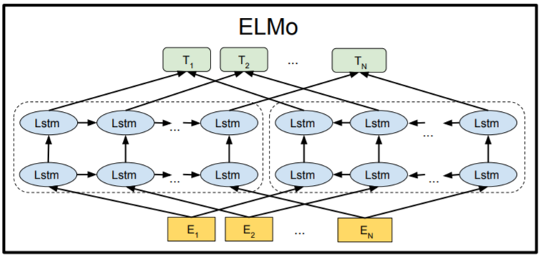
Introducing ELMo
Paper with deep insight: ”Deep contextualized word representations”, Peters et al, https://arxiv.org/pdf/1802.05365.pdf
Word vectors with context!
Bi-directional LSTM architecture, trained on 1bn+ word corpus on LM task
Final forward/backward vectors are concatenated
Model also returns output for intermediate layers
Image Source: ”BERT: Pre-training of Deep Bidirectional Transformers for Language Understanding”, Devlin et al, ,https://arxiv.org/pdf/1810.04805.pdf
Notes:
Talk through the architecture. Details of initial word-embeddings from running a CNN over character-level embeddings not crucial here.

Slide 40
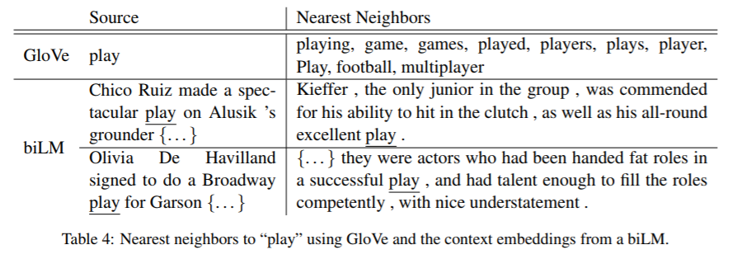
Some ELMo Results: GloVe vs Context Embeddings
Source: ”Deep contextualized word representations”, Peters et al, https://arxiv.org/pdf/1802.05365.pdf

Slide 41
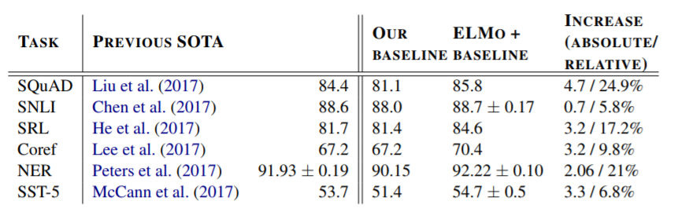
Comments
ELMo is available for download - full model is downloaded, not just the few embedding vectors!
Critical - Very useful for downstream NLP tasks! Notes:
Language tasks use additional layers on top of ELMo.
Pre-trained models were fine-tuned for task
States from LSTM layers were actually mixed in for some models.
Source: ELMo paper: https://arxiv.org/pdf/1802.05365.pdf

Slide 42
Outlook: Beyond ELMo - Transfer Learning with BERT, OpenAI’s GPT, and Sentence Embeddings with USE

Slide 43
Even More Impressive Language Models
Can we do better?
Yes, we can! (But details will have to wait a couple of weeks...)
Key idea: Transformer Architecture
“‘Relate’ words in a sequence With each other to build output vectors/embeddings
Faster! Better!
Image source (with blocking of less-relevant parts): https://research.googleblog.com/2017/08/transformer-novel-neural-network.html

Slide 44
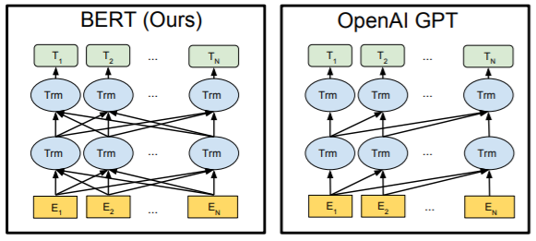
BERT & GPT: Transformer Architectures
Word vectors with context!
Image Source: ”BERT: Pre-training of Deep Bidirectional Transformers for Language Understanding”, Devlin et al, ,https://arxiv.org/pdf/1810.04805.pdf

Slide 45
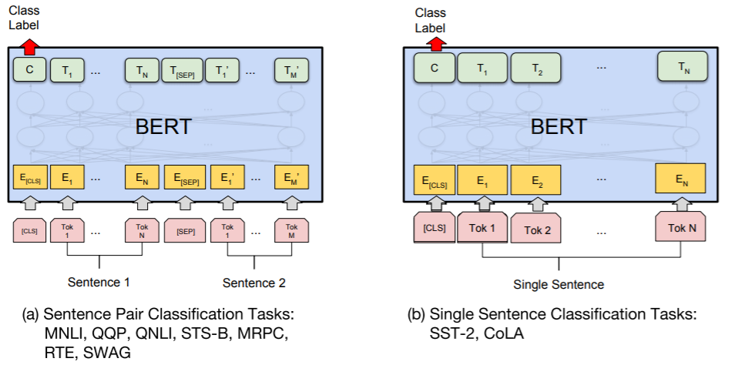
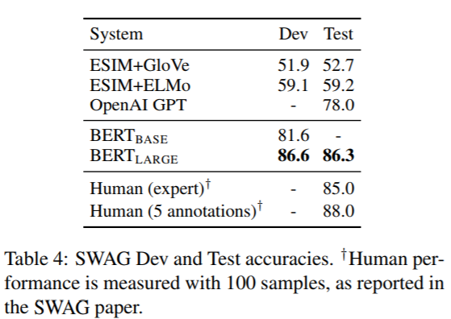
Transfer Learning!
(BERT) Pretrained on two tasks: i) Language Model & ii) ‘Is this the next sentence?’
Fine-tuning of pre-trained model for many other tasks! (Add simple classification layer to pre-trained model)
”BERT: Pre-training of Deep Bidirectional Transformers for Language Understanding”, Devlin et al, ,https://arxiv.org/pdf/1810.04805.pdf

Slide 46
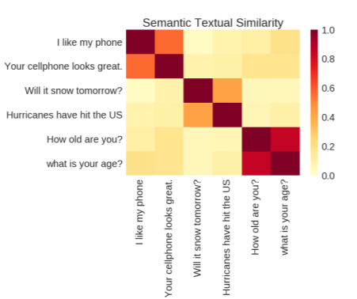
Beyond Word Embeddings: Universal Sentence Encoder
“Can we go beyond words and capture a whole sentence in a vector?” Yes! Using very similar ideas (“Universal Sentence Encoder”, Cer et al, https://arxiv.org/pdf/1803.11175.pdf)
Map sentence to 512-dimensional vector via similar model, trained on multiple tasks
Reuse pre-trained model for your own classifications tasks with limited data!

Slide 47
That’s it for today!
W266: Natural Language Processing

Slide 48
Play with USE & BERT Notebooks from TensorFlow Hub

Slide 49
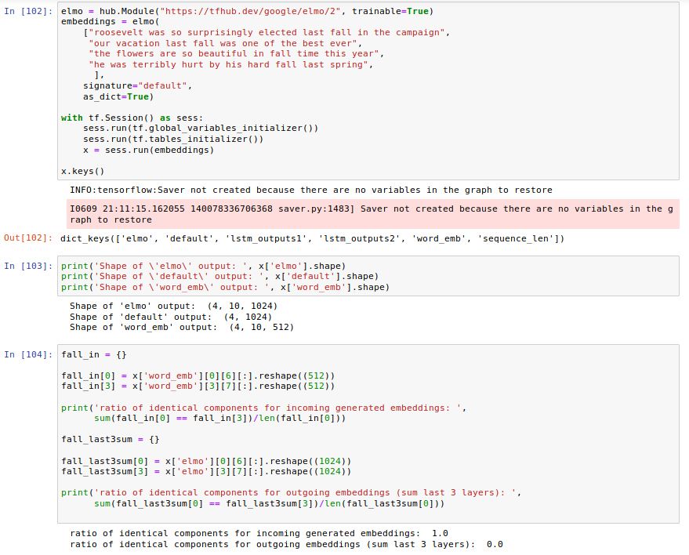
ELMo in Action
Outputs of ELMo model (from tensorflow hub):
word_embed: generated incoming embeddings
lstm_outputs1: first LstM hidden state
lstm_outputs2: second LSTM hidden state
elmo: weighted sum of three layers
default: sentence embedding
Sequence_len: length of sequences

Slide 51
Simple Recurrent Neural Net
Question: “If dim(h_1) = 100 and dim(h_2) = 50 .. What is the dimension of W_2?”
Question: “If dim(h_1) = dim(x) = 100.. What is the dimension of W_1?”
Diagram from Colah's Understanding LSTM Networks http://colah.github.io/posts/2015-08-Understanding-LSTMs/
Notes:
h = g(xW + b)
g = tanh
x = [x h_{t-1}]
h_t = tanh([x, h_t-1]W + b)

